Slide 1
EDA and Machine Learning on Ghouls Prediction
INSAID

Slide 2
Content
Problem Statement
Data Visualization
Model development and evaluation
Feature selection
Summary

Slide 3
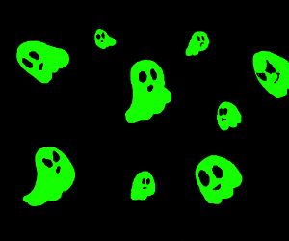
Problem Statement
The main aim of this dataset is to categorize Ghost, Ghoul and Goblin based on their bone length measurements, severity of rot, extent of soullessness, and other characteristics to distinguish (and extinguish) the intruders

Slide 4
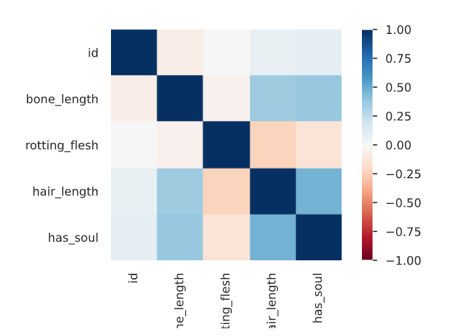
About the Dataset
Overview :
Number of variables: 7
Number of observations: 371
Missing cells: 0 (0.00%)
Total size in memory: 59.6.0 KiB
Variables types:
Numeric = 5 Categorical = 2 Boolean = 0
Text (Unique) = 0 Rejected = 0

Slide 5
Next…
Data Visualization

Slide 6
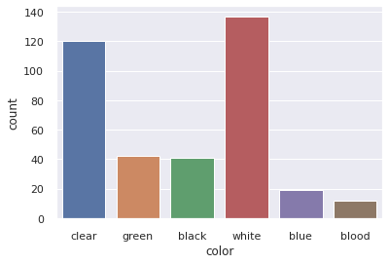
Analyse the highest color occurrence in the data
We can see that white has the highest occurrence among other others.

Slide 7
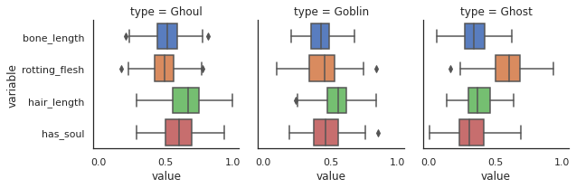
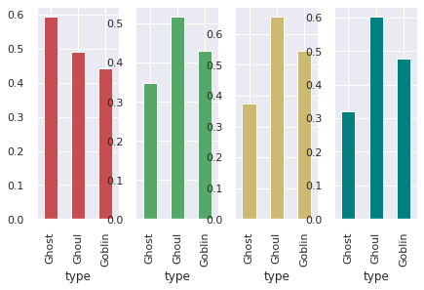
Analse the group by types according wrt to other column features
We can see that Ghost have highest number of rotten flesh.
We can see that Ghouls have highest bone length.
We can see that Ghouls have longest hair.
We can see that Ghouls have highest soul among others.

Slide 8
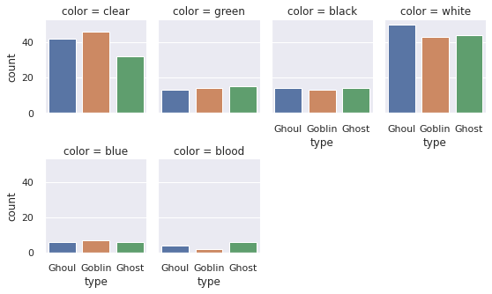
Analyse the group by types according wrt to other colors

Slide 9
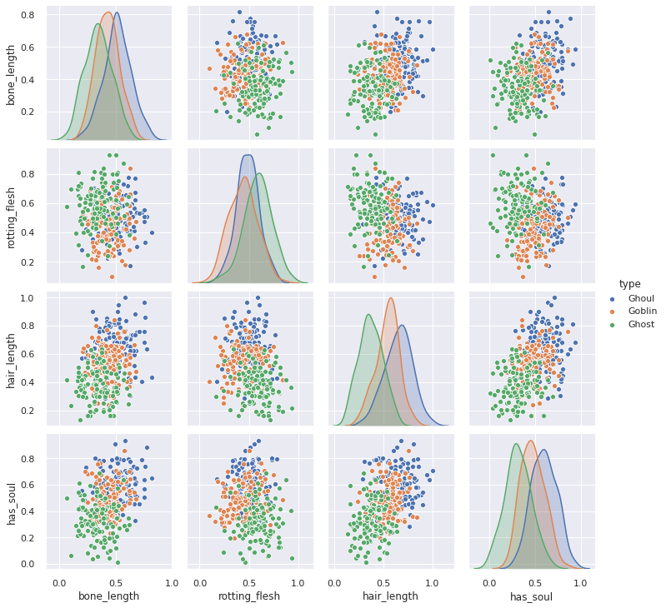
Pairwise Plot

Slide 10
Next…
Model Development & Evaluation:

Slide 11
Model Development & Evaluation: 1. Linear Regression model1
MSE: 0.7304582210242587
By performing the Logistic Regression algorithm we are getting accuracy 0.7304582210242587

Slide 12
2. Naïve Bayes
MSE: 0.7196765498652291
By performing the Naive-Bayes algorithm we are getting accuracy 0.7196765498652291

Slide 13
3. XGBoosting Classifier Algorithm
MSE: 0.921832884097035
By performing the XGB classifier algorithm we are getting accuracy 0.921832884097035 which is really good.

Slide 14
Next…
Ada Boost and Feature Selection

Slide 15
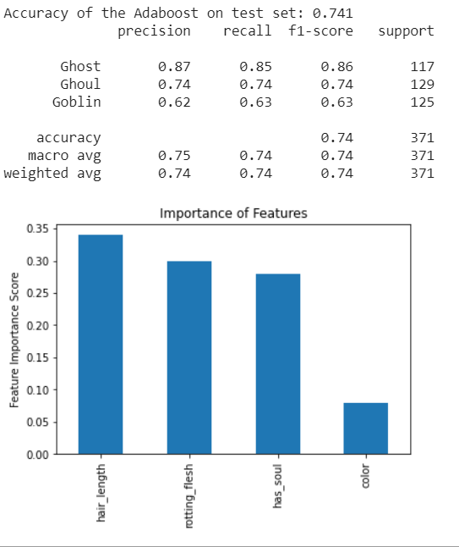
Ada Boost and Feature Selection

Slide 16
Conclusion
We investigated in depth about the features i.e. which features are important to retain and which to discard.
We performed EDA to understand the relationship between every column.
We know how different features affected the target variable.
We constructed different machine learning models like XGBoost, Naive Bayes, linear regression model, Ada boost model and got best result with XGBoost model.
We performed feature selection to know that hair length is the most important feature amoung others.

